Slide 1




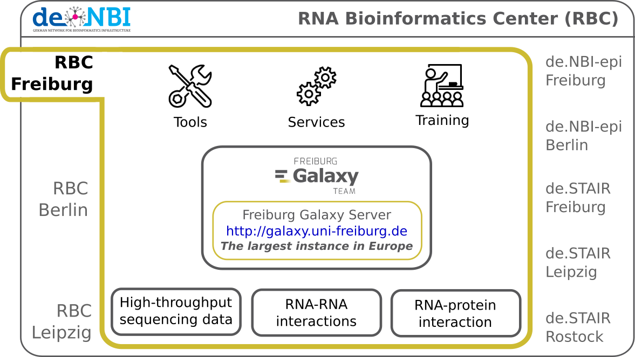

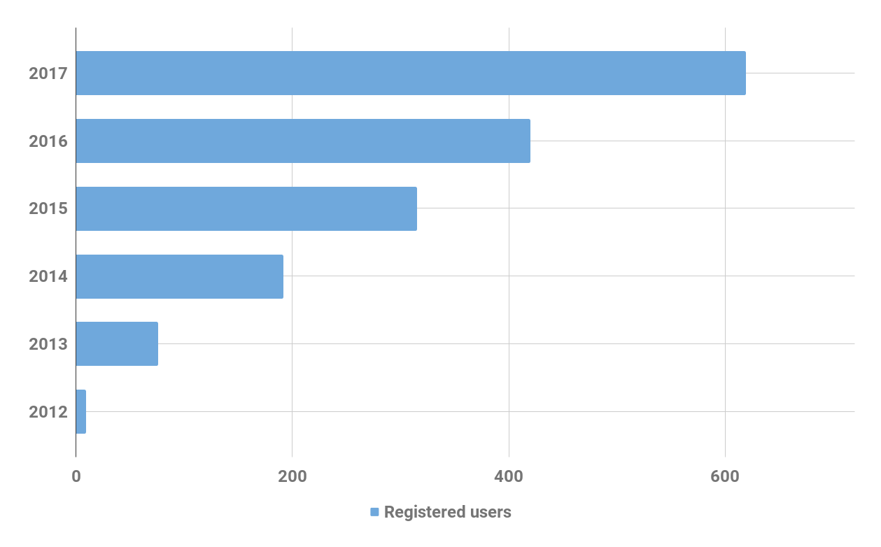
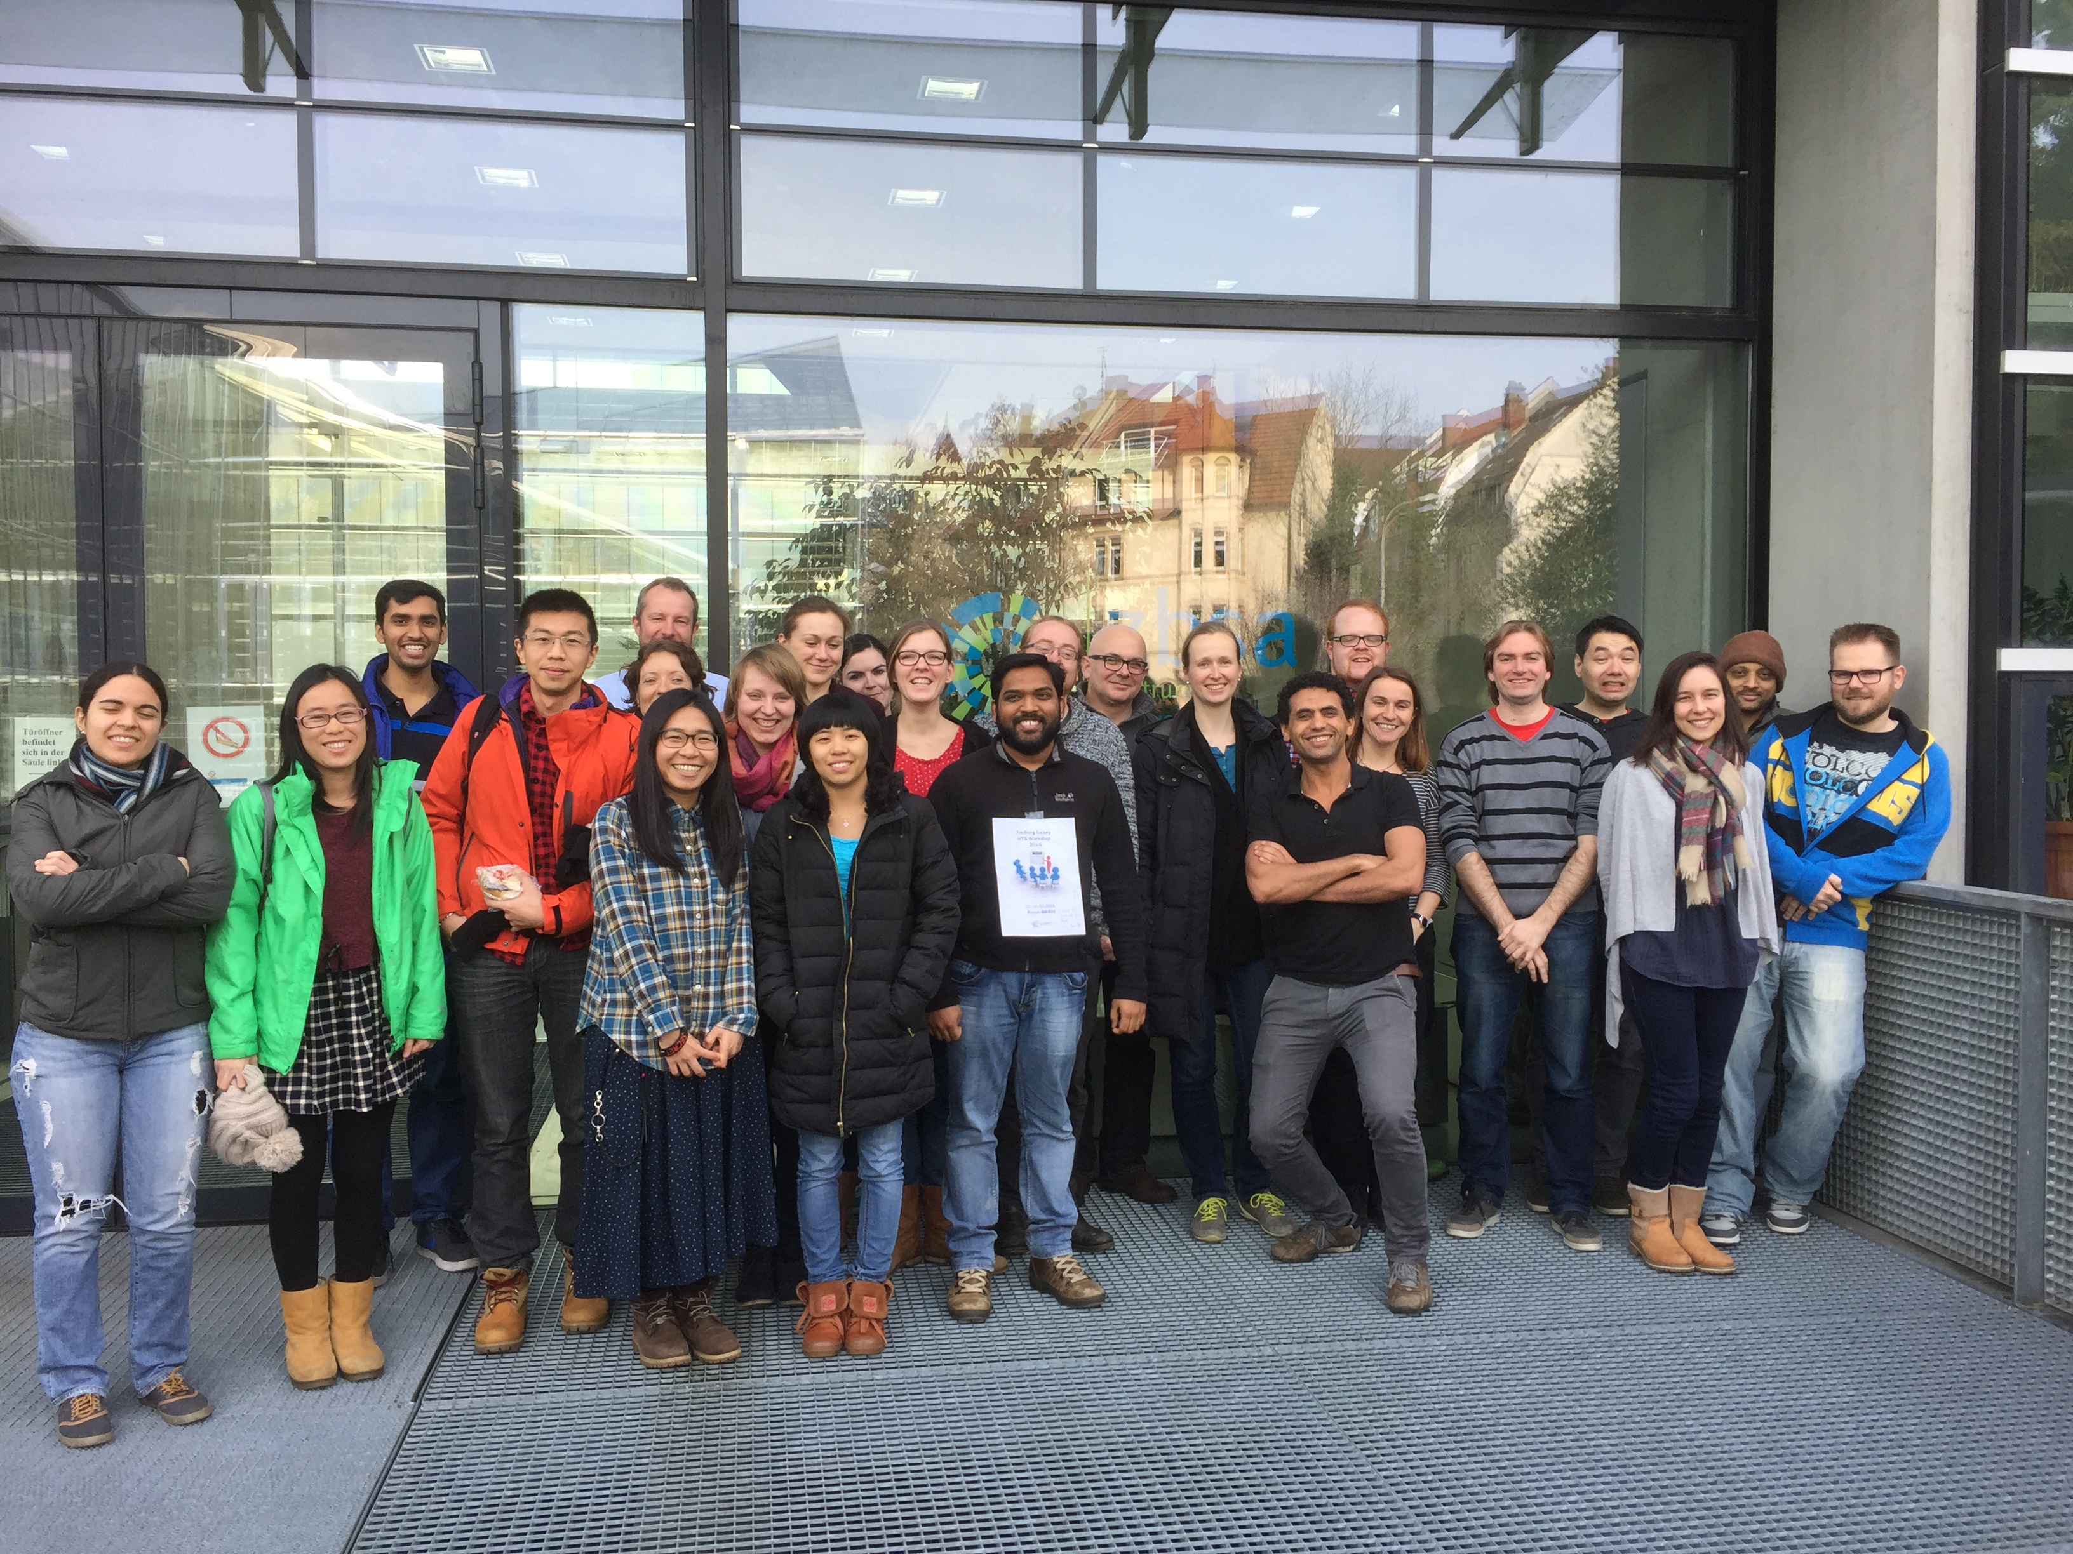
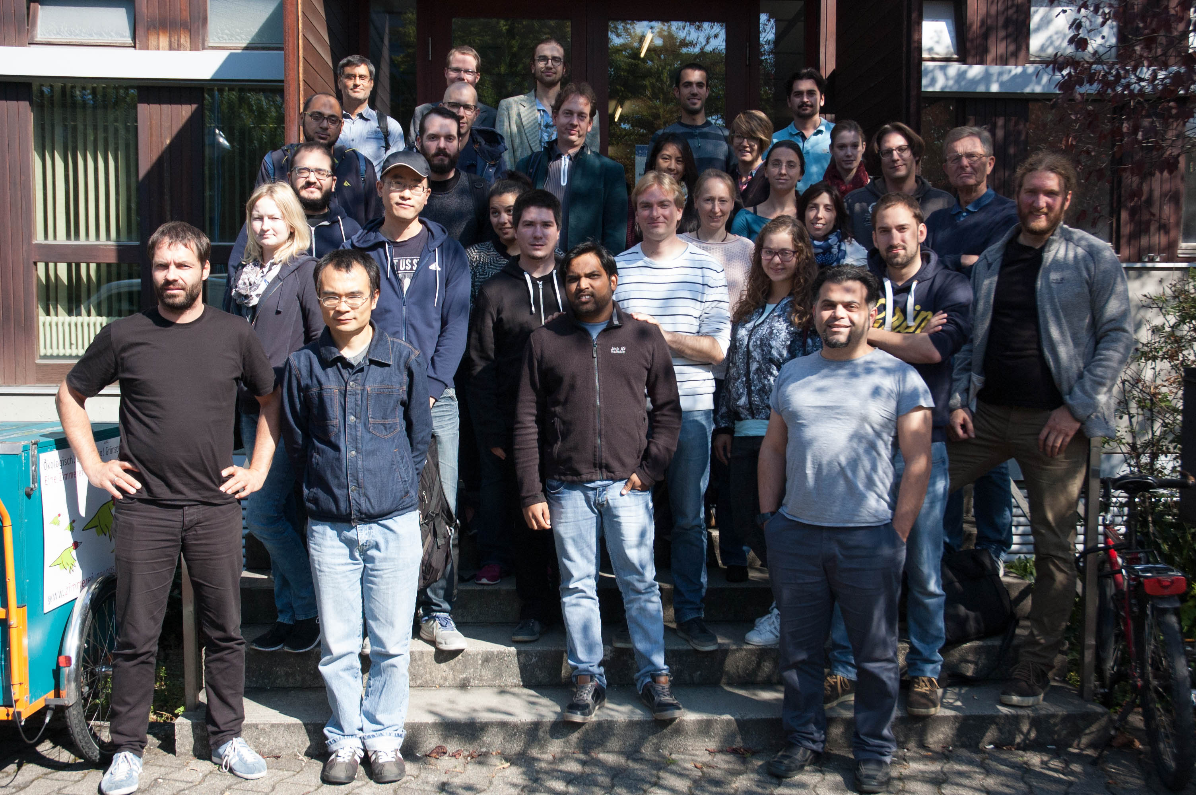




RBC-FR
RNA Bioinformatics Center
University of Freiburg
Chair of Bioinformatics
Fkz 031A538A
Anika Erxleben, Torsten Houwaart, Bérénice Batut, Eric Rasche, Björn Grüning, Rolf Backofen
University of Freiburg, Germany
Description of de.NBI-RBC
de.NBI cloud activities
ELIXIR AAI workshop in Freiburg
Production-ready OpenStack instance
Monitoring via Zabbix and Grafana of Hardware and Software
Preconfigured, packer-based, virtual appliance
Galaxy Cloud integration
CloudLaunch integration
Progress report
Training and education
Organisation of
Several training courses to teach users common HTS techniques, tool development, and Galaxy implementation
Contribution fests to make software more readily available
Migration of our training material and analysis workflow documentation to online repositories for easier collaboration: training.galaxyproject.org
Ongoing curation and development of training material for newer tool versions and new emerging techniques requested by users
Active participation in the Biostars forum to answer user questions
Services
Ongoing evaluation of new analysis techniques, methods and software for RNA-RNA and RNA-protein interactions
Development and maintenance of standard analysis pipelines and definition of SOPs
Close cooperation and knowledge exchange with ELIXIR.
General information on the project
As part of the RBC project in Freiburg, Anika Erxleben, Torsten Houwaart, Bérénice Batut and our Cloud-Admin Eric Rasche, are working closely together with other de.NBI partners and ELIXIR to deliver high-class services for RNA-related research.
de.NBI services
de.NBI training and education
The Freiburg Galaxy Server
(https://galaxy.uni-freiburg.de) enables scientists to perform accessible, reproducible and transparent research of biomedical data.
As part of the de.NBI cloud, the Freiburg Galaxy Server will be available for all German research facilities in the beginning of 2018.
The RBC Freiburg offers biannual full-day hands-on Galaxy training weeks on HTS data analysis: >300 participants in the last 3 years.
We also offered Galaxy developer workshops in cooperation with ELIXIR and we organised several contribution fests.
The RBC Freiburg is actively involved in making software user-accessible. Tools relevant for HTS data analysis, RNA-protein interaction analysis (e.g. CLIP experiments), RNA-RNA interaction analysis are made available through distribution channels such as Bioconda.
Freiburg Galaxy HTS data analysis workshops February (left) and September 2016 (right)
The Freiburg RNA server (http://rna.informatik.uni-freiburg.de) offers a series of RNA research tools:
Sequence-structure alignments: LocARNA, CARNA, MARNA
Clustering: ExpaRNA
Interaction prediction: IntaRNA, CopraRNA
Homolog identification: GLASSgo
Sequence design: AntaRNA, INFORNA, SECISDesign
CRISPR repeat analyses: CRISPRmap
2015/2016 events
8 hackathons and 12 workshops
2017 events
09th – 10th Jan | Galaxy QIIME codefest | Online
16th – 19th Jan | European Galaxy developer workshop | Strasbourg
26th – 27th Jan | Galaxy RNA Seq & admin workshop | Mainz
02nd – 09th Feb | Galaxy Australasia Meeting workshop | Melbourne
13th – 17th Feb | Galaxy HTS data analysis workshop | Freiburg
09th – 10th Mar | Software Carpentry workshop | Freiburg
15th Mar | ELIXIR webinar | online
21st – 22th Mar | ELIXIR IAA hackathon | Freiburg
04th – 05th Apr | AAI workshop | Freiburg
22nd – 24th May | ELIXIR Galaxy Training hackathon | Cambridge
01st – 02nd Jun | Repro hackathon | Gif-sur-Yvette
28th – 29th Jun | GCC workshops (4) | Montpellier
21st Jul | ISMB/ECCB workshop | Prag
2017/2018 planned events
18th – 22nd Sep | Galaxy HTS data analysis workshop | Freiburg
25th – 29th Sep | de.NBI Summer School workshops | Berlin
9th – 11th Oct | BioContainers hackathon | Paris
18th – 20th Oct | Software Carpentry workshop | Heidelberg
08th – 12th Jan | Galaxy admin workshop | Oslo
19th – 23th Feb | Galaxy HTS data analysis workshop | Freiburg
Analysis frameworks for specific tasks are made available as Docker images. They incorporate a Galaxy web server with seamlessly included tools, SOP analysis pipelines, training material, a Galaxy interactive tour, and help pages.
Publications
Tools and data services registry: a community effort to document bioinformatics resources.
The Galaxy platform for accessible, reproducible and collaborative biomedical analyses: 2016 update.
The RNA workbench: best practices for RNA and high-throughput sequencing bioinformatics in Galaxy
Enhancing pre-defined workflows with ad hoc analytics using Galaxy, Docker and Jupyter.
Global RNA recognition patterns of post-transcriptional regulators Hfq and CsrA revealed by UV crosslinking in vivo.
RC3H1 post-transcriptionally regulates A20 mRNA and modulates the activity of the IKK/NF-kappaB pathway.
www.denbi.de

